Slide 1
Breaking Down Labor Supply Convergence: A Quantitative Approach
Nam Vo, Diego De Loera, Jesus Ponce

Slide 2
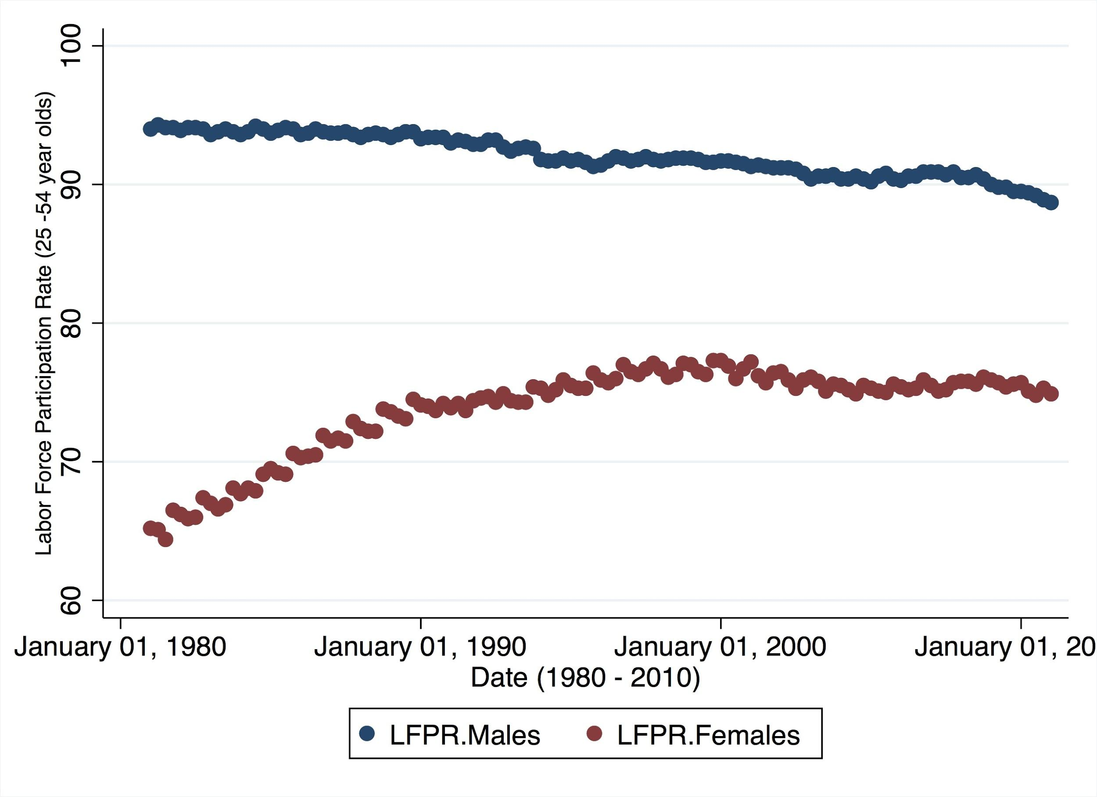
Historical Trends (LFPR)
Convergence of LFPR between sexes
Males
Females
Due to:
Shifts in Demand for Labor
Relationship b/w returns to education and educational attainment
Changing Social Norms
Quantifying relevant economic variables within a regression equation
Labor Force Participation Rates (25-54 yr olds)
Date: 1980-2010

Slide 3
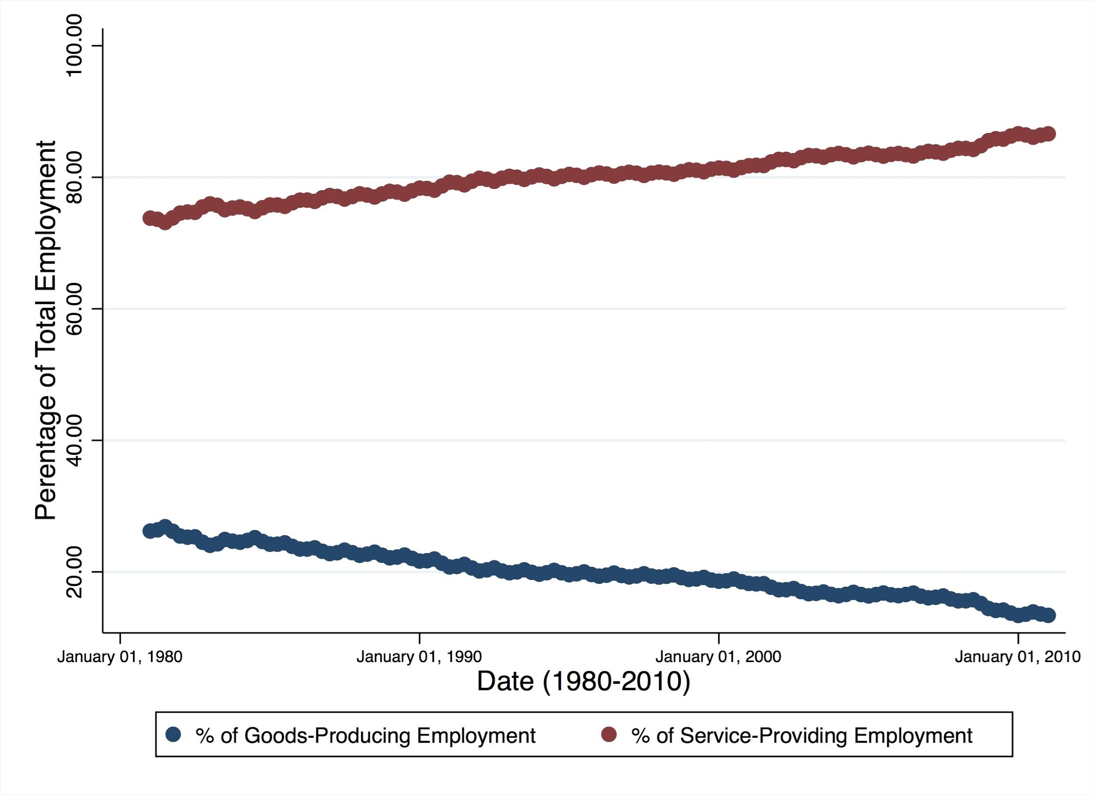
Historical Trends (Sectoral Shifts)
Divergence between Employment Sectors:
Manufacturing
Service
Exporting low-skilled Labor
Strong Correlation b/w service sector and female labor force participation rate
Share of Total Employment
Date: 1980-2010
Notes:
Seen a continued growth of services
Process of deindustrialization
Ex: retail, restaurants, white collar jobs

Slide 4
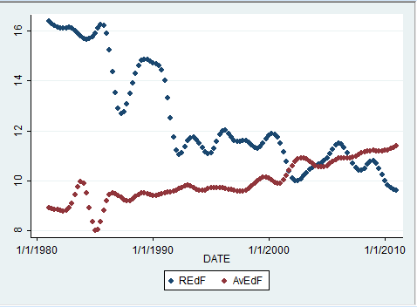
Historical Trends (Returns To Education)
Convergence of Returns to Education and Educational Attainment
The trend is similar for males
Shift from manufacturing centric jobs to service
Increased educational attainment
Increased saturation of degrees
Reduced returns to education
Female Returns to Education and Educational Attainment Date: 1980-2010

Slide 5
Theoretical Framework: Income - Leisure Model
Real Wages ( w )
Goods
w ( ), H ( ), L ( )
w
I
H
T
Hrs Leisure

Slide 6
Theoretical Framework: Income - Leisure Model
Real Wages ( w )
Goods
w’
w ( ), H ( ), L ( )
w
I
H’
H
T
Hrs Leisure

Slide 7
Theoretical Framework: Income - Leisure Model
Real Wages ( w )
w”
Goods
w’
w ( ), H ( ), L ( )
w
I
H’
H
T
Hrs Leisure
H”

Slide 8
Theoretical Framework: Income - Leisure Model
Non-Labor Income ( I )
Goods
Spouse’s Income ( ), I ( ):
Divorces ( ), I ( )
I
I ( ), H ( ), L ( )
H
Hrs Leisure

Slide 9
Theoretical Framework: Income - Leisure Model
Non-Labor Income ( I )
Goods
Spouse’s Income ( ), I ( ):
Divorces ( ), I ( )
I
I’
I ( ), H ( ), L ( )
H’
H
Hrs Leisure

Slide 10
Tools & Expectations
Estimator: Ordinary Least Squares (OLS)
Data; Type, Frequency, Interval: time-series data, quarterly, 1980-2010
Ln(LFPR)_{f}=β₀+β₁Ln(REarn_{f})-β₂Ln(REarn_{m})+β₃Divr+β₄(gr_ShareSPEmp)+ε
LFPR_{f}= Female labor force participation rate (%)
REarn_{f}= Female real earnings ($ per week)
REarn_{m}= Male real earnings ($ per week)
Divr = Divorce Rates (% Divorces/Marriages)
gr_ShareSPEmp = Growth of the share of the service sector (%)

Slide 11
Other Relevant Variables We Explored, but did not Include in our Methods
Educational Attainment
Returns to Education
Fertility Rates
Labor Force Participation Gap (as a dependant)
Share of Manufacturing Jobs

Slide 12
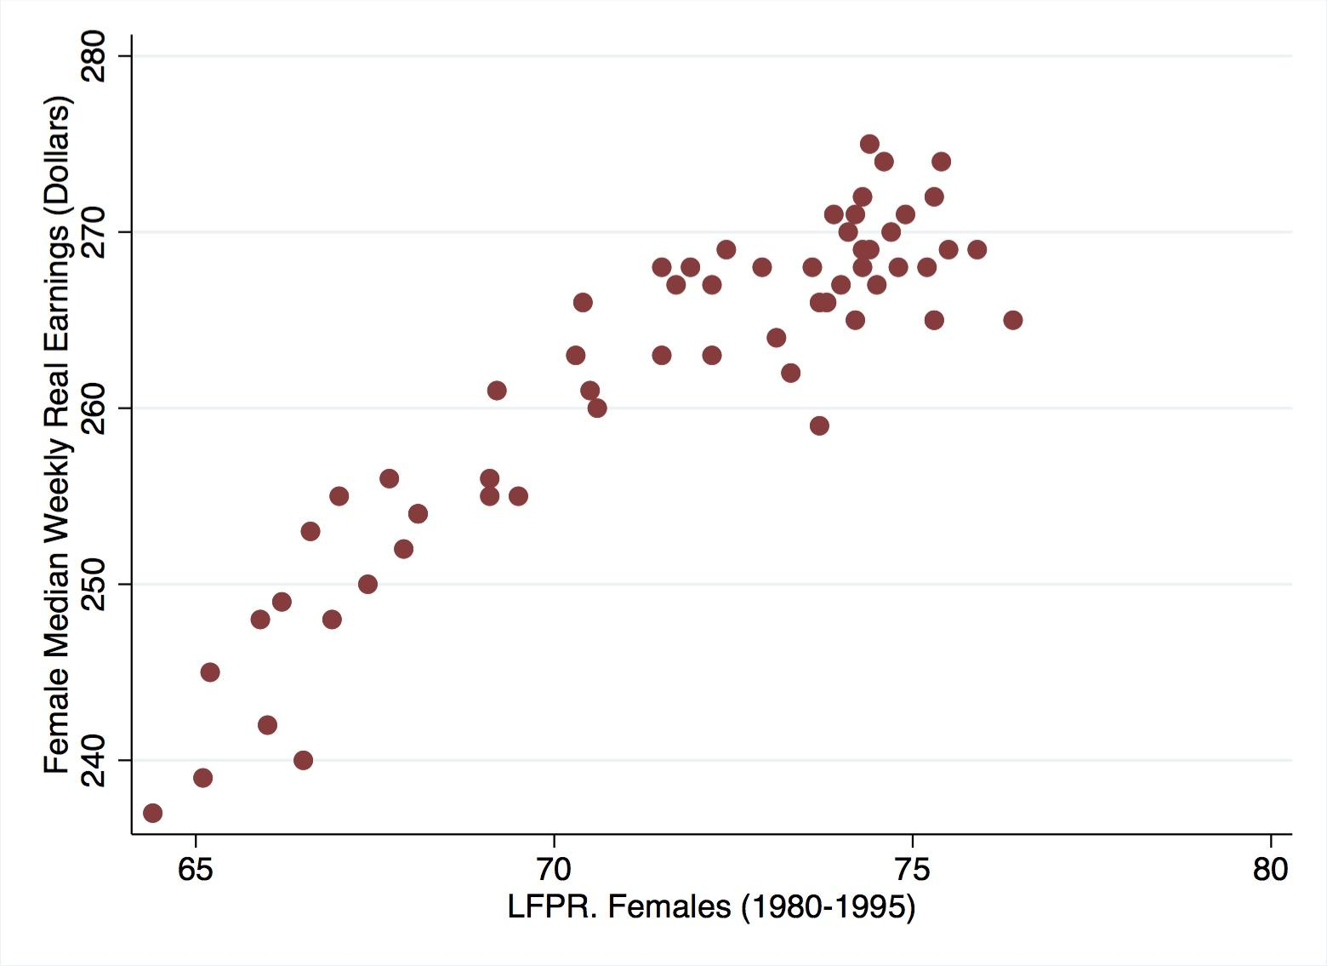
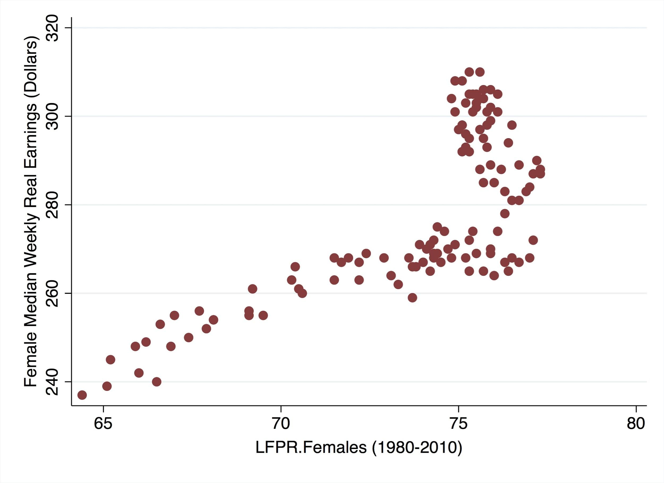
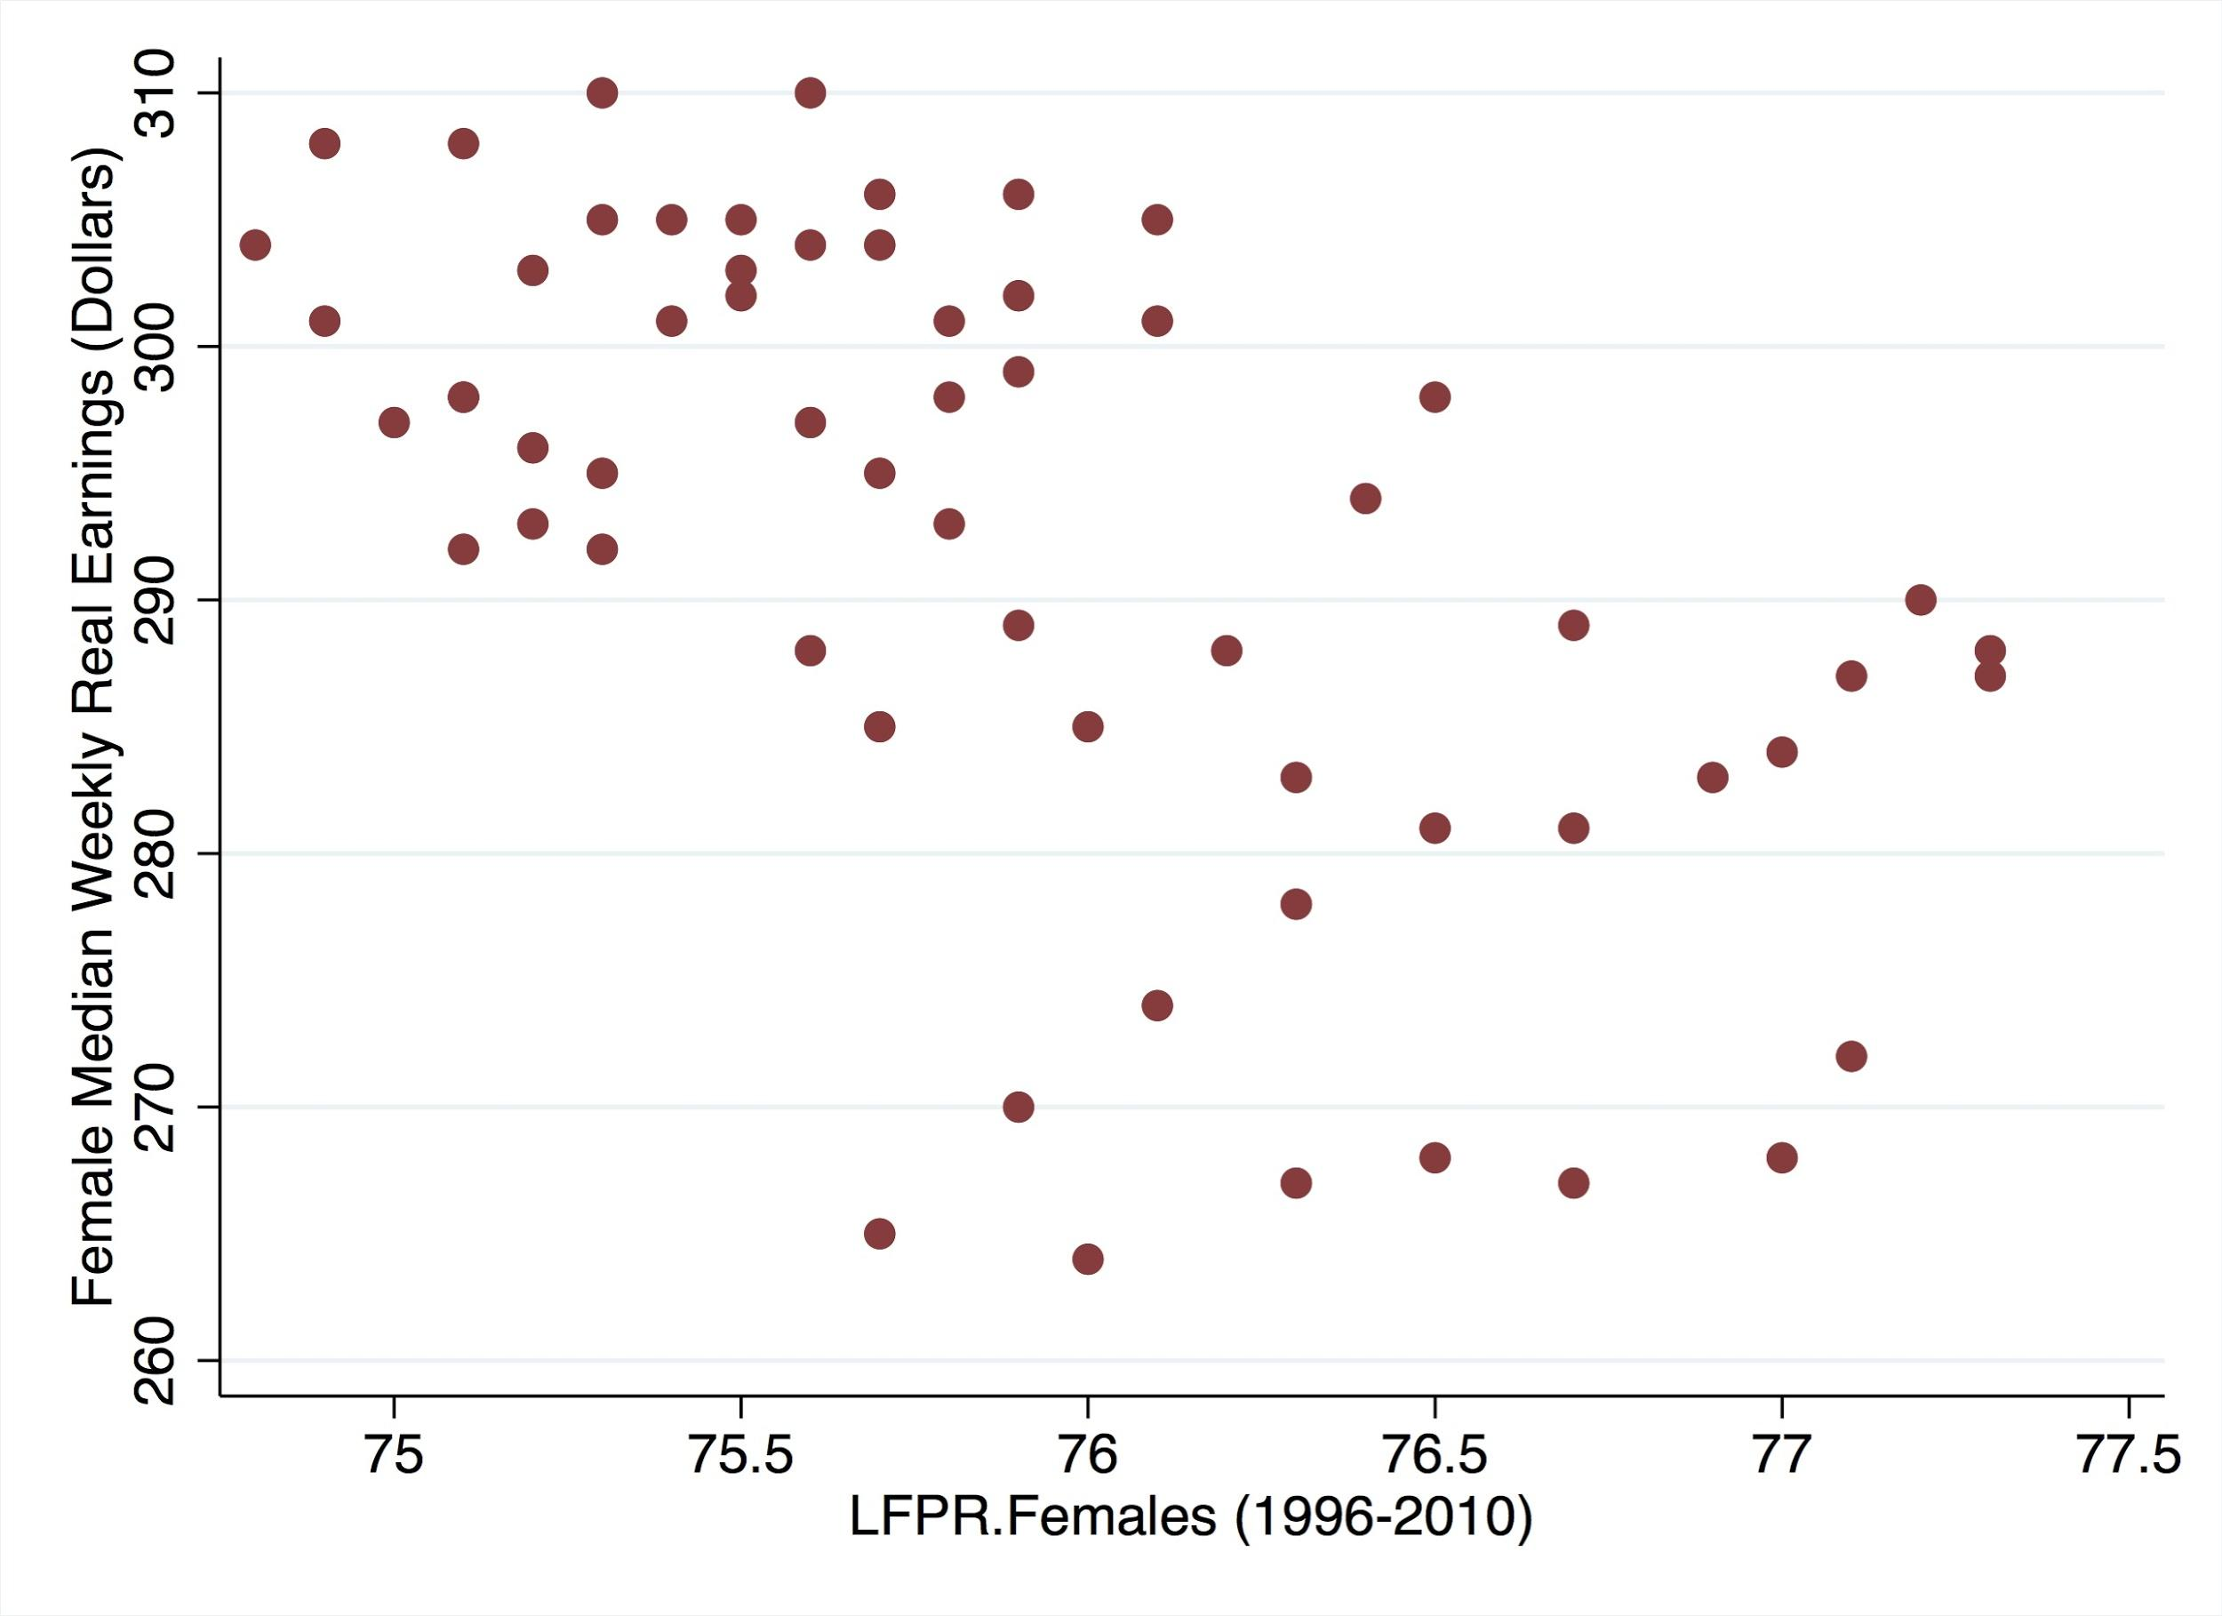
Female “Labor Supply”
1980-2010
1980-1995
1996-2010
As earnings increase, LFPR increases
Upward-sloping LFPR
As earnings increase, LFPR decreases
Inflexion point of LFPR
Backward-bending labor supply
At inflexion point, higher earnings can not induce more LFPR

Slide 13
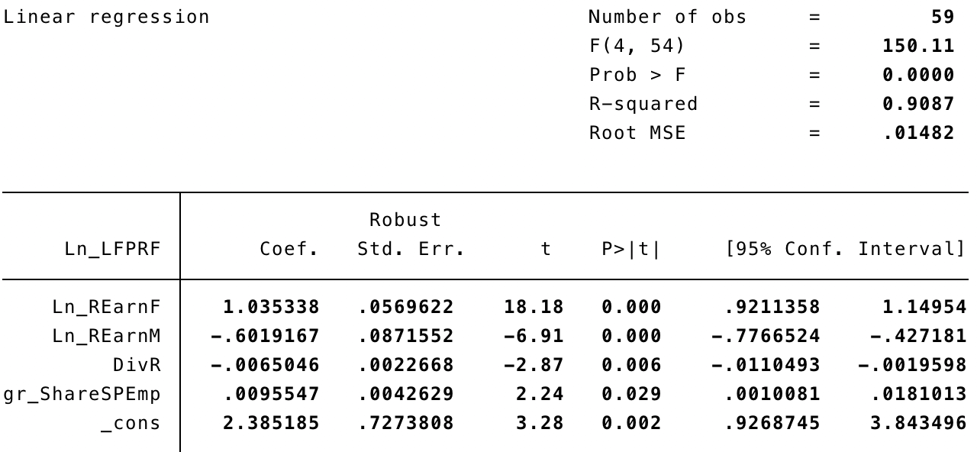
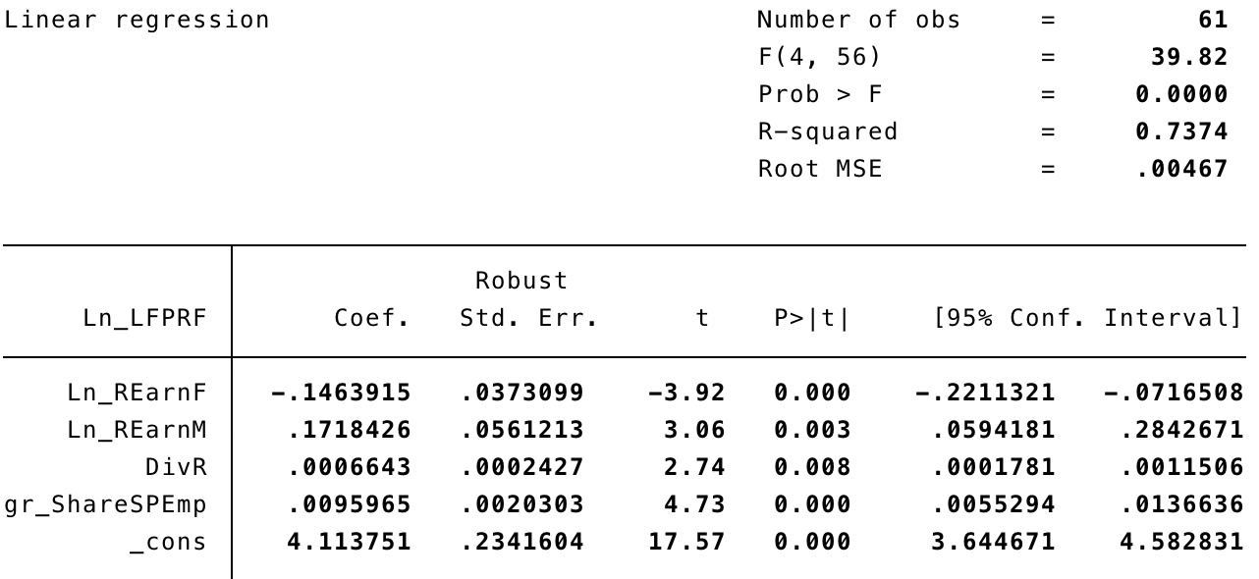
Data and Graphs (Social Norms)
1980-1995
1996-2010
Own-Wage LFPR Elasticity = 1.04
Cross-Wage LFPR Elasticity = -.6
Own-Wage LFPR Elasticity = -.146
Cross-Wage LFPR Elasticity = .172
An OLS model for each time frame (1980-1995) & (1996-2010)
Notes:
“Not only are there economic reasons why women now need to work, but women are also more likely to choose to work even when not economically compelled to do so through wages

